Slide 1
Websites and other Tasty Toastmasters Tech
Luke Donabauer

Slide 2
Introduction/Overview
Creating your digital image
Marketing your club online
TI Branding
Online platforms (Freetoasthost/ wordpress)
Website tips
Easy Speak

Slide 3
Creating your digital image
How do you want your club to present?
Who is your target audience?
Examples

Slide 4
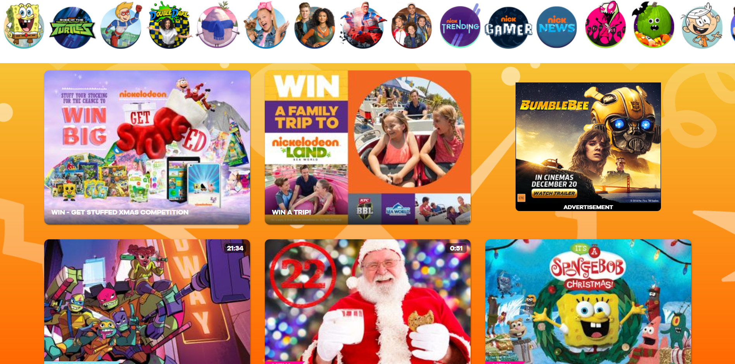
Notes:
Who does it appeal to?
How?
Website: Nickelodeon

Slide 5
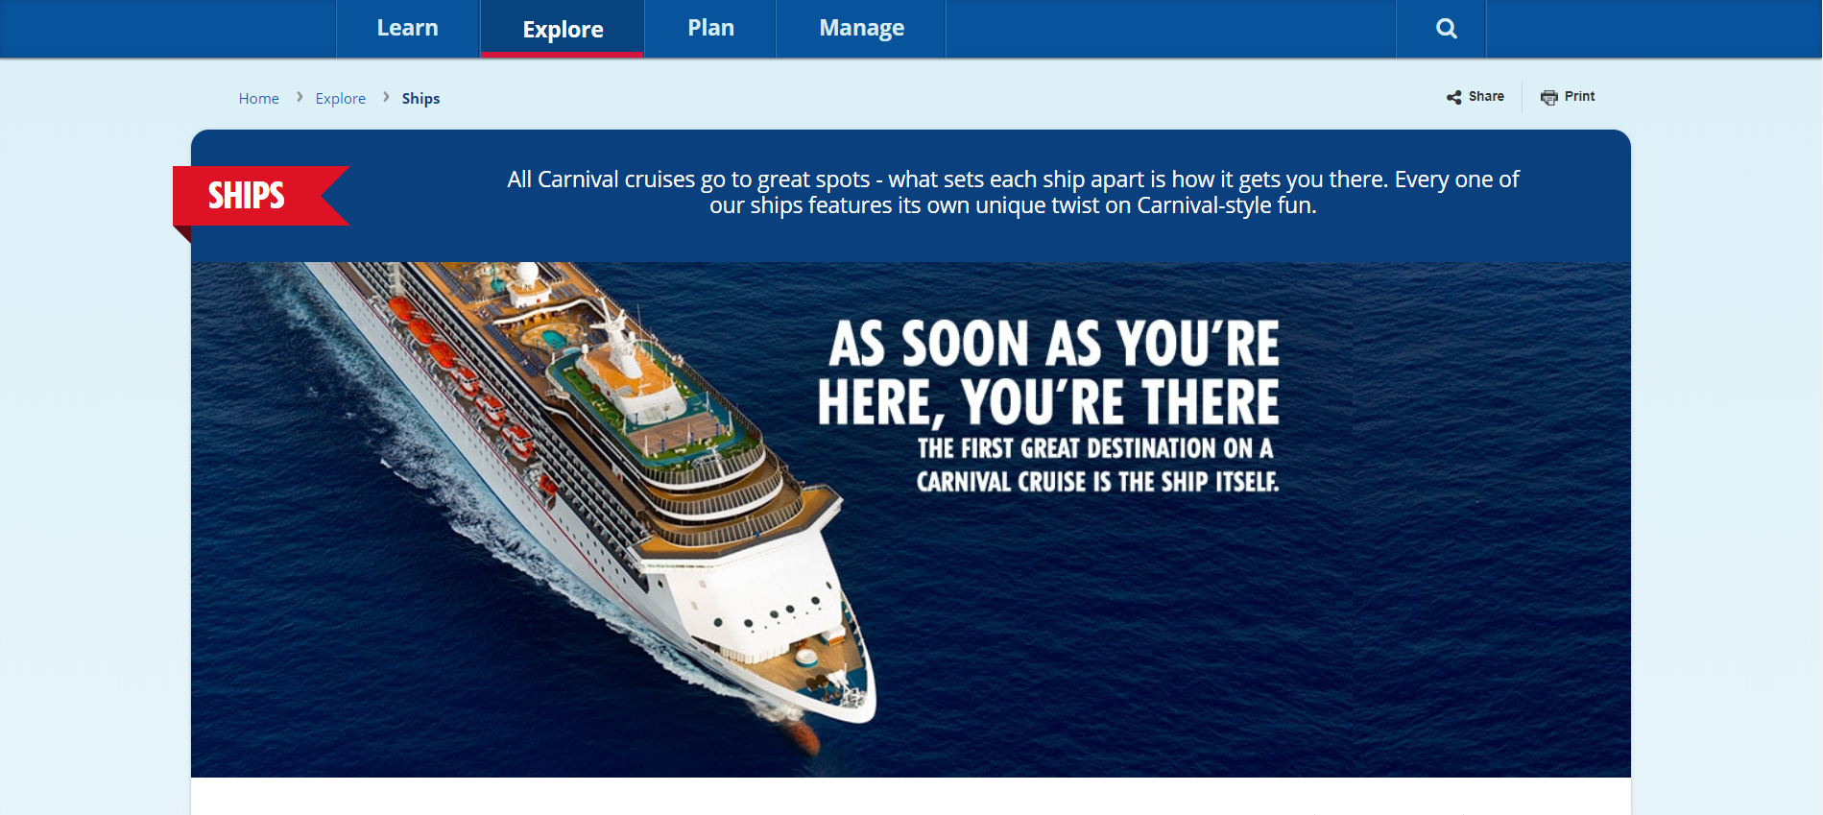
Notes:
Who does it appeal to?
How?
Website: Nickelodeon

Slide 6
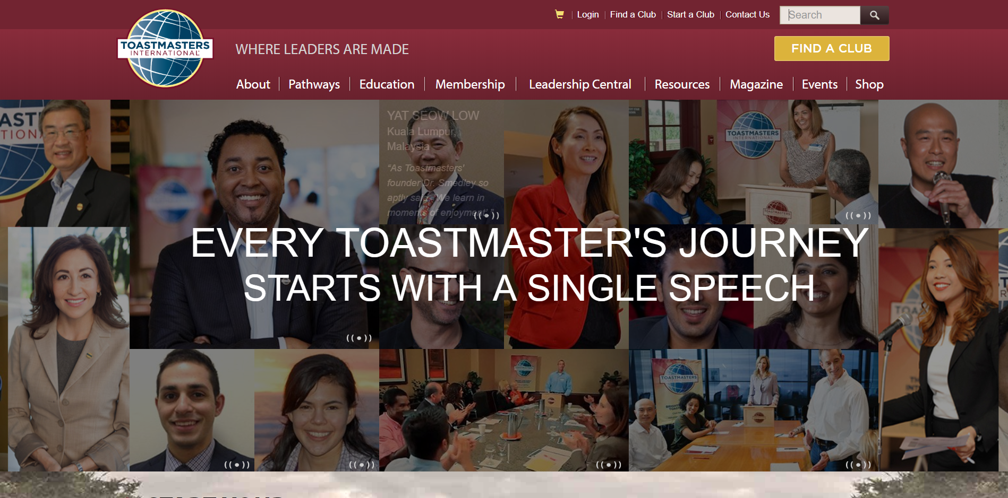
Notes:
Who does it appeal to?
How?
Website: Nickelodeon

Slide 7
Creating your digital image
After analysing these websites, who here is confident their website is effectively targeting their selected audience?
What about demographics?
Case study

Slide 8
Toastmasters Branding
Available in the Brand Manual:
Click here for Brand Manual
Also available in the visual Brand Guidelines:
Click here for Visual Brand Guidelines
(For images/colours/ typography..etc)

Slide 9
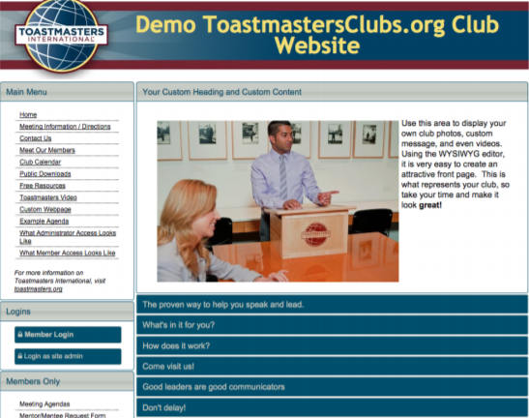
Platforms
FreeToastHost
A free service provided by TM International
If your club is looking to take up the offer, you can request it here:
Click here for FreeToastHost Resources
There is also plenty of resources available to assist you (user docs/ forum or even the ability to register for website support!)
You can also download the website masterheads from this page

Slide 10
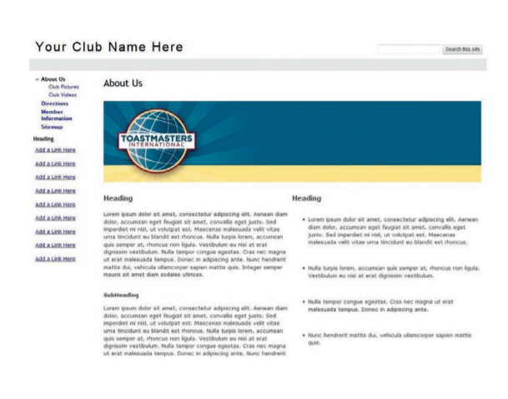
Platforms
Google and Wordpress websites
Whilst there is no TM guide specifically for these platforms at the moment, wordpress is by far the most customizable platform
You can make it as simple/ complex as you want
There is a massive amount of resources already in existence for the use of these platforms

Slide 11
Website tips
Update regularly (meeting times & content)
Limit amount of site admins (less people are changing content)
Ensure ease of handover (at changeover)
Ensure regular engaging content is uploaded
  Use clear and descriptive headings
  Include media (images/videos..etc)
  Link in multiple sites (facebook/ d90..etc)

Slide 12
Easyspeak
Very handy tool once mastered for the VPE in that it acts as a workflow system, can keep track of projects & roles completed and can autofill agendas!
Has a function for VPM to track guests/ file note accordingly (when they were contacted and if they’ll be available next month..etc)
It’s completely free!
Any questions, please let me know and I’ll work with Sally Morton afterwards to put a FAQ together

Slide 13
Conclusion
So why cover this topic?
With the rollout of Pathways, this put digitalisation in our sites – something that all modern organisations require
It’s always important to consider your target audience and demographic to best attract attention from the public
The slides will be available

Slide 14
Thank you!!

